Slide 1
Brain Mapping
SAKSHAM PRUTHI
sakshamp@iitk.ac.in
190743

Slide 2
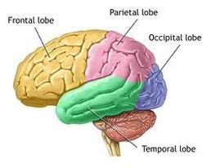
Research Paper: Frequency-dependent changes in sensorimotor and pain affective systems induced by empathy for pain
DISCUSSION
Introduction
α and β band desynchronization
Low γ band desynchronization
Effect of empathetic pain on the contralateral motor cortex

Slide 3
INTRODUCTION
As described, EEG and MEG readings were analysed by a stimuli which showed movies depicting pain, under the condition that MEP(motor evoke potentials) suppression was observed.
The major focus point of the discussion would be to outline the relationship between oscillation variations in frequency bands and somatic as well as cognitive aspects of empathy for pain.

Slide 4
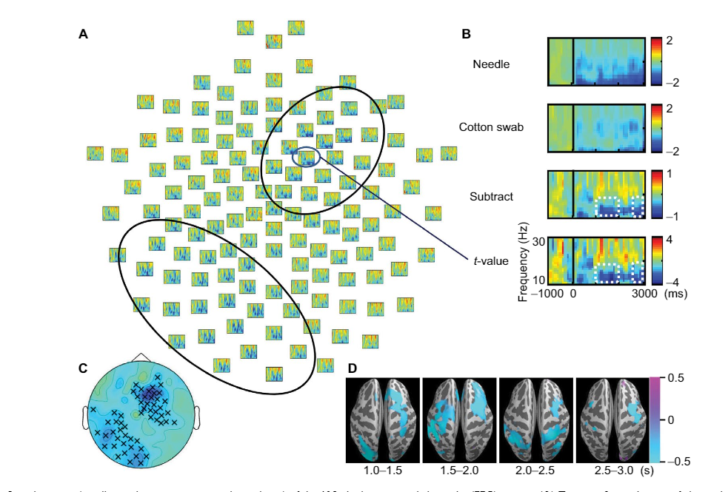
α and β band desynchronization
The study highlighted an enhanced suppression of alpha and beta band power values, particularly in right frontocentral and left parietooccipital regions of the brain, confirmed by MEG readings. The readings are inconsistent with VAS score.
It is hypothesized that this is due to activation of somatic sensorimotor region.
The Lack of consistency with VAS score further implies sensorimotor contribution.
There was a predominance of right hemisphere in frontal band desynchronization, and not bilateral central regions, hence arguing this is not mere activation of somatosensory area.
There was a predominance of left hemisphere in parietooccipital band desynchronization, and these changes were due to empathy ad emotion regulation. Touch involves activation of parietal cortices
Therefore, these two might be linked and also lead to MEP suppression.

Slide 5
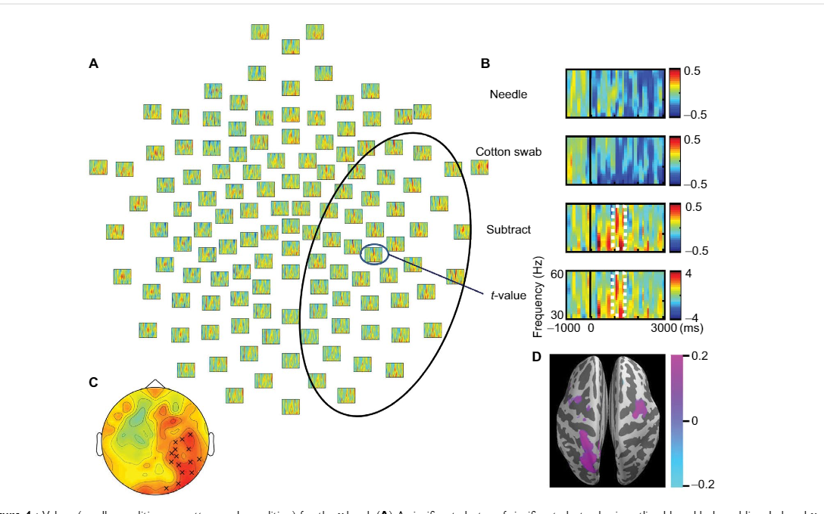
Low γ band desynchronization
Gamma band oscillations are involved in temporal tuning, working towards tuning the neurons against particular stimuli and encouraging custom synaptic changes.
Gamma band a major role in pain processing, decreased desynchronization was observed after 1000-1500 ms, and a correlation between power and VAS score may indicate the relation between gamma band’s decreased suppression and empathetic pain processing, the cognitive aspect.
Decreased band suppression was observed over right sensorimotor area and Emotional affective processing occurs mainly in anterior cingulate cortex, anterior
insula, or other deeper structures. Subcortical networks are involved but difficult to estimate.
Other cognitive processes also play a role and empathetic pain processing involves cognitive functions too. Therefore it is possible that Gamma band modulation implies cognitive aspects.

Slide 6
Effect of empathetic pain on the contralateral motor cortex
A decrease in MEP amplitudes of M1 cortex was found which indicate inhibition of corticospinal tract. Ina previous study, MEP amplitudes were found to decrease in specific particular muscle groups and a change is observed in cases of extreme stimuli and vary to first and third person perspective, also collateral modulation is observed to different stimuli.
Somatosensory and motor cortices are deeply connected thus, MEP inhibition may occur through somatosensory modulation.

Slide 7
Limitations
Small sample size, Role of sex could not be evaluated
Frequency range was determined arbitrarily
EEG, MEG and MEP were not recorded simultaneously and VAS done for only EEG
Repetitive viewing may lead to habituation

Slide 8
CONCLUSION
Results suggest that α/β band suppression is involved in the processing of somatic aspects of empathy for pain, which in turn results in inhibition of M1 excitability. γ oscillations most likely reflect the cognitive aspects of pain assessment.

Slide 9
EEGLAB Tutorial: Chapter 06: Data Averaging
EEGLAB contains several functions for plotting 1-D ERP averages of dataset trials (epochs), EEGLAB also features functions for studying the EEG dynamics expressed in the single trials, which may be visualized
In ERP-image plots, EEG data epochs (trials) are first sorted along some relevant dimension (for example, subject reaction times, within-trial theta power levels, mean voltage in a given latency window, alpha phase at stimulus onset, or etc.), then (optionally) smoothed across neighboring trials, and finally color-coded and visualized as a 2-D rectangular color (or monochrome) image.

Slide 10
timtopo() scalp maps plots the average ERP by latency. Each trace plots averaged ERP at one channel according to specified epoch latency and plots 2d scalp map of highest average ERP (430 ms for sample dataset)
plottopo() plots ERPs of the epoched dataset in a 2D arrangement.
topoplot() plots 2D ERP scalp maps at specified latencies
headplot() plots 3D ERP scalp maps at specified latencies.
headplot can also specify custom channel locations through Polhemus system relative to a template head surface, this is called co-registration.

